Slide 1
CYBER ATTACK DETECTION MODEL FOR NETWORK INTRUSION USING MACHINE LEARNING TECHNIQUE
Under the Guidance of : Mr. Y. Siva
Done By :
KAMUJU NOVA (19R11A0517)
VANKAYALAPATI VINITHA (19R11A0544)
VUDHANTHI NEERAJA (19R11A0548)

Slide 2
CONTENTS
Abstract
Existing System And Proposed System
System Configuration
System Architecture
Modules
Advantages and Disadvantages
UML Diagrams
Templates
Conclusion

Slide 3
Abstract
An Intrusion Detection System (IDS) is a device or software application that monitors a network for malicious activity or policy violations.
The present form of IDS are:
Signature-based IDS: is the detection of attacks by looking for specific patterns, such as byte sequences in network traffic, or known malicious instruction sequences used by malware.
Anomaly-based intrusion detection systems were primarily introduced to detect unknown attacks, in part due to the rapid development of malware. This is a dynamic approach.
The are major problems that are encountered in the existing systems are :
Signature-based IDS can easily detect known attacks, it is difficult to detect new attacks, for which no pattern is available.
While the anomaly-based intrusion detection approach enables the detection of previously unknown attacks, it may suffer from the time-consumption during detection process that degrades the performance of IDS’s.
In order to tackle this issue, in our proposed system, we have made use of Machine Learning algorithm and recursive feature selection to analyse and detect the type of intrusion.

Slide 4
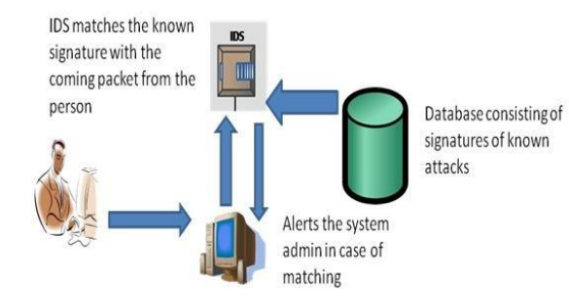
Existing System
Signature-based IDS:
Signature-based detection is typically used for identifying known threats. It operates by using a pre-programmed list of known threats and their indicators of compromise (IOCs).
An IOC might be a specific behavior that generally precedes a malicious network attack, file hashes, malicious domains, known byte sequences, or even the content of email subject headings.
As a signature-based IDS monitors the packets traversing the network, it compares these packets to the database of known IOCs or attack signatures to flag any suspicious behavior.

Slide 5
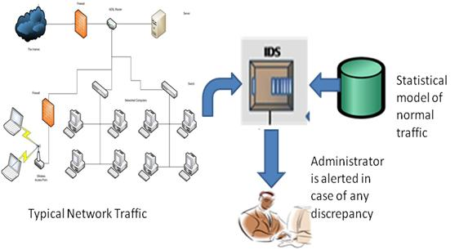
anomaly-based IDS:
anomaly-based intrusion detection systems can alert you to suspicious behavior that is unknown. Instead of searching for known threats, an anomaly-based detection system utilizes machine learning to train the detection system to recognize a normalized baseline.
The baseline represents how the system normally behaves, and then all network activity is compared to that baseline. Rather than searching for known IOCs, anomaly-based IDS simply identifies any out-of-the-ordinary behavior to trigger alerts.
IDSs normally measure the data set based on the linear regression algorithm and KNN algorithms from security experts or formulate intrusion detection method that considers all the features of the attack.
Currently only using the KDD99 datasets which has only 38 features.

Slide 6
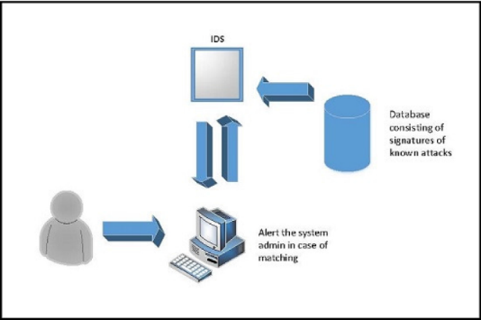
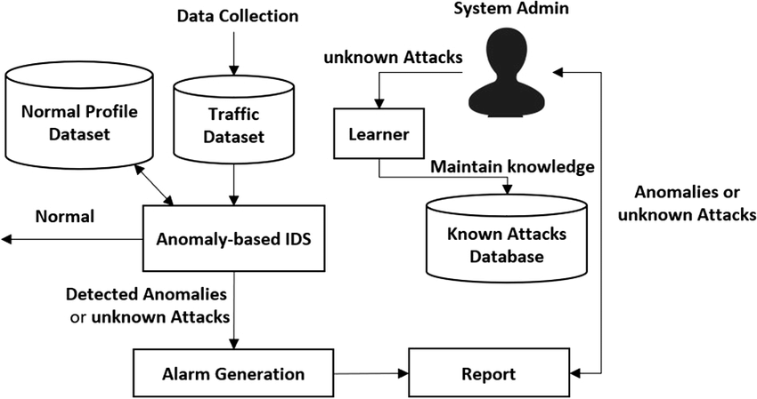
Existing system architecture
SIGNATURE-BASED IDS ARCHITECTURE
ANOMALY-BASED IDS ARCHITECTURE

Slide 7
Proposed System
The initial model is trained on KDD dataset which has KDDTrain and KDDTest datasets which consists of 126,620 and 22,850 records respectively. The datasets have the features such as:
Basic features: It contains all features which derived from TCP/IP connection such as Protocol_type, Service, duration and etc.
Time-based traffic features: It is used to capture those features which are mature over a 2 second temporal window (e.g. count, srv_count, Rerror_rate and etc.)
Content features: Those features use domain knowledge to access the payload of the original TCP packets (e.g. hot, num_root, is_guest_login and etc.)
Host-based traffic features: all attacks which span longer than 2 second intervals that have the same destination host as the current connection are access using these features (e.g. dst_host_count, dst_host_srv_count and etc.)
The classes or labels in the NSL KDD dataset are divided into four categories which represent the attack class and one as normal traffic: Denial of Service (DoS), Probe, Remote to Local (R2L), User to Root.

Slide 8
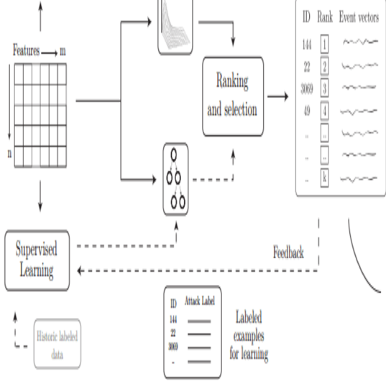
Nowadays with the emergence of new technologies such as Cloud Computing or Big Data, large amount of network traffic are generated and the intrusion detection system must dynamically collected and analyzed the data produce by the incoming traffic.
However in a large dataset not all features contribute to represent the traffic, therefore reducing and selecting a number of adequate features may improve the speed and accuracy of the intrusion detection system.
In our project, a feature selection mechanism has been proposed which aims to eliminate non-relevant features as well as identify the features which will contribute to improve the detection rate, based on the score each features have established during the selection process.
To achieve that objective, Univariate feature selection using ANOVA that make use of F-test and a recursive feature elimination which gets importance from previous selection was employed and associated with a decision tree based classifier and later on, the suitable relevant features were identified.

Slide 9
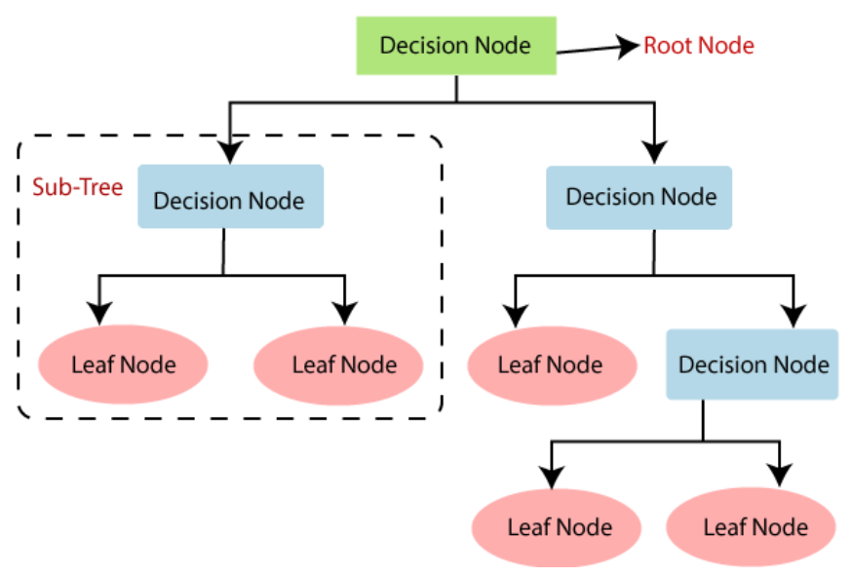
The algorithm used in our IDS model is:
Decision Tree
Decision Tree:
It is a tree-structured classifier, where internal nodes represent the features of a dataset, branches represent the decision rules and each leaf node represents the outcome.
In a Decision tree, there are two nodes, which are the Decision Node and Leaf Node. Decision nodes are used to make any decision and have multiple branches, whereas Leaf nodes are the output of those decisions and do not contain any further branches.
In our project, the patterns based on the Indicators of Compromise (IoC) are represented as the branches (which makes up the path from one decision node to the other.) and the type of the attack is given by the leaf nodes.
The decision tree algorithm helps us find patterns and paths from the data that is available and it is has a predicted accuracy of 93% which has a upper hand over the currently used KNN algorithm.

Slide 10
System Configuration
Software Requirements
Operating system : MICROSOFT/MAC
Python IDE : PyCharm/ VS Code/ Sublime Text
Programming languages : Python
Front end programming languages :HTML, CSS, Javascript
Internet Explorer Versions : Chrome v-119, Microsoft Edge
Hardware Requirements
CPU : Intel Core 2 Quad Processor Intel I5/I7
RAM : 8 GB or greater
Hard Drive Storage : SSD – 256 GB

Slide 11
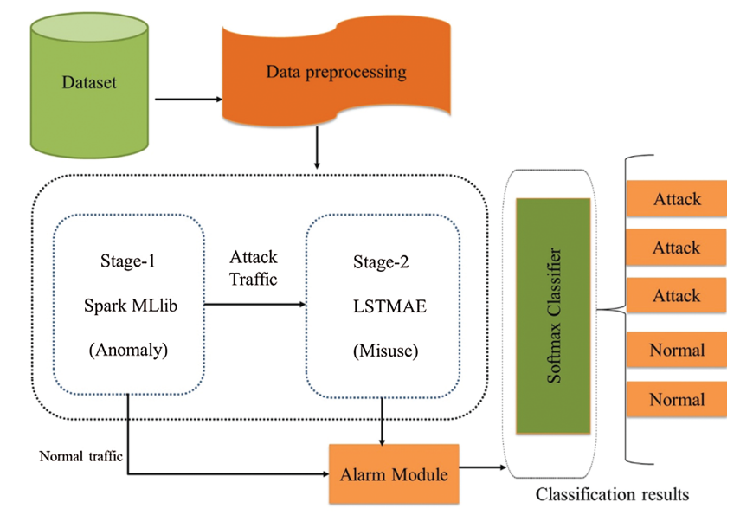
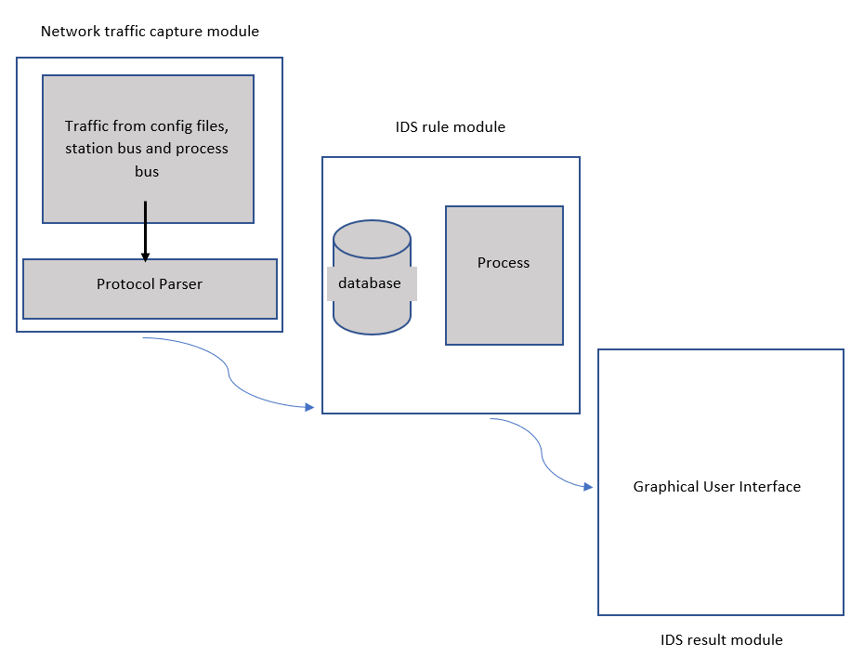
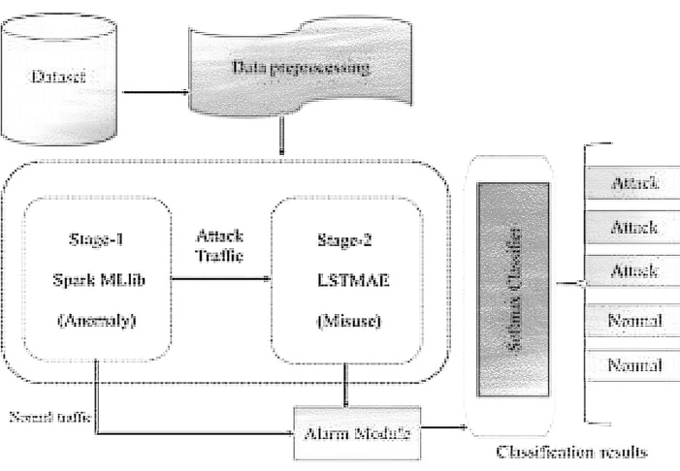
System Architecture

Slide 12
Modules
User:
The network traffic capture module is on the user system and collects data regarding the network.
Network traffic capture module :
In this module, protocol parser is used for real-time capturing and parsing of traffic.
IDS rule and result module:
Rule Module: This module is the most critial component of the proposed IDS and is developed to implement the decision tree algorithm and ANOVA F-test elimination process. A database is set up for the IDS, which stores critical status parameters of the IDS system in order to realize multiple packets.
Result Module: The detection results are demonstrated on the IDS graphical user interface (GUI).

Slide 13
Advantages
Low False Alarm Rate
High detection rate
high detection accuracy
Pattern finding is made possible because it uses decision tree algorithm
Efficient because it uses feature scaling and feature extraction

Slide 14
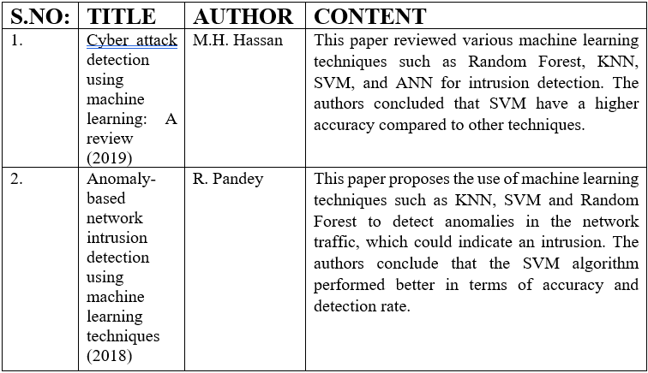
Literature Survey

Slide 15
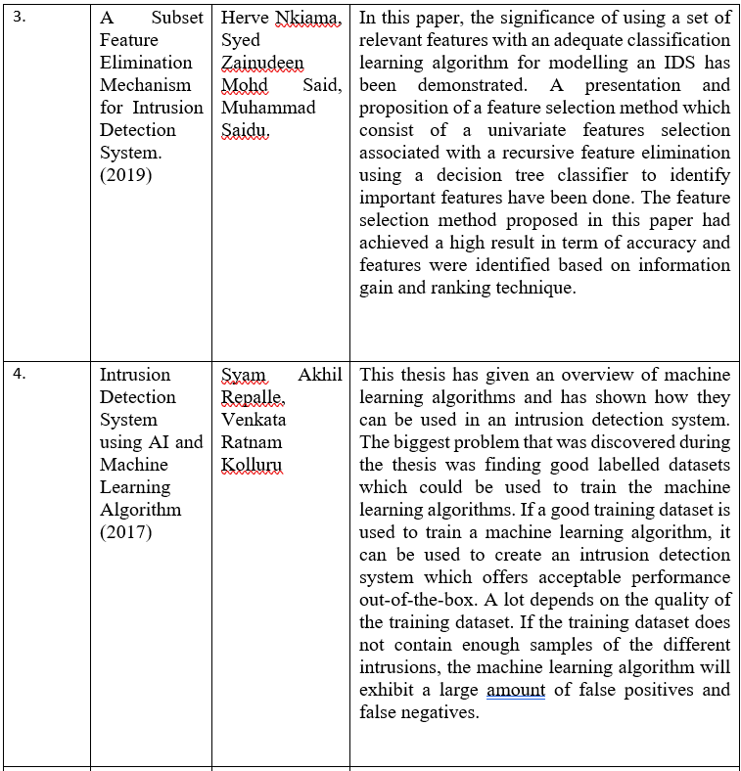

Slide 16
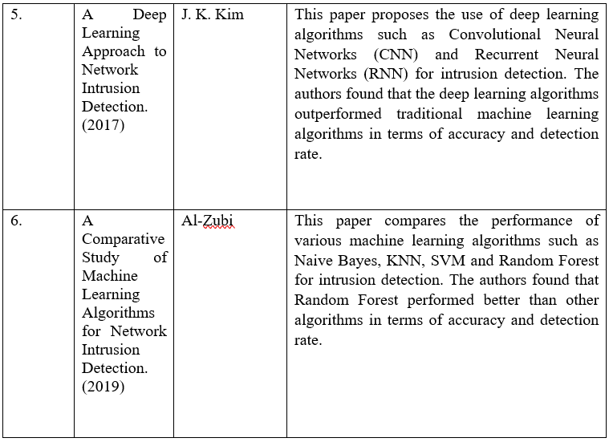

Slide 17
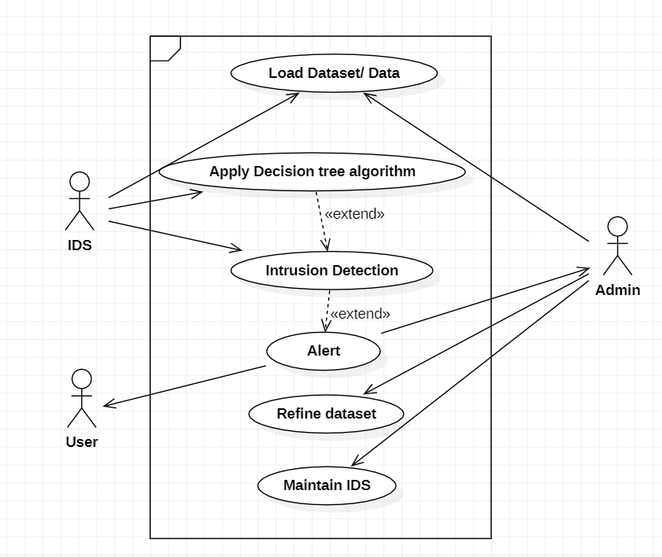
UML Diagrams Usecase diagram

Slide 18
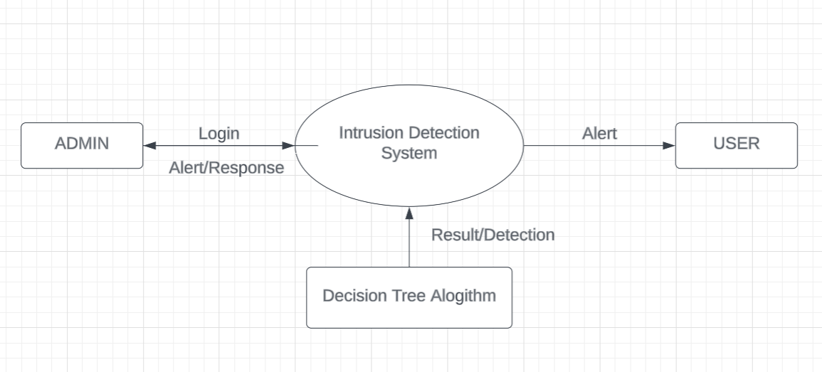
Level – 0 Data Flow Diagram

Slide 19
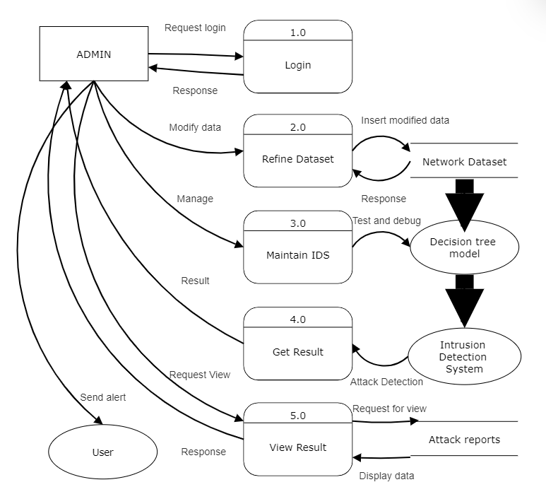
Level – 1 Data Flow Diagram

Slide 20
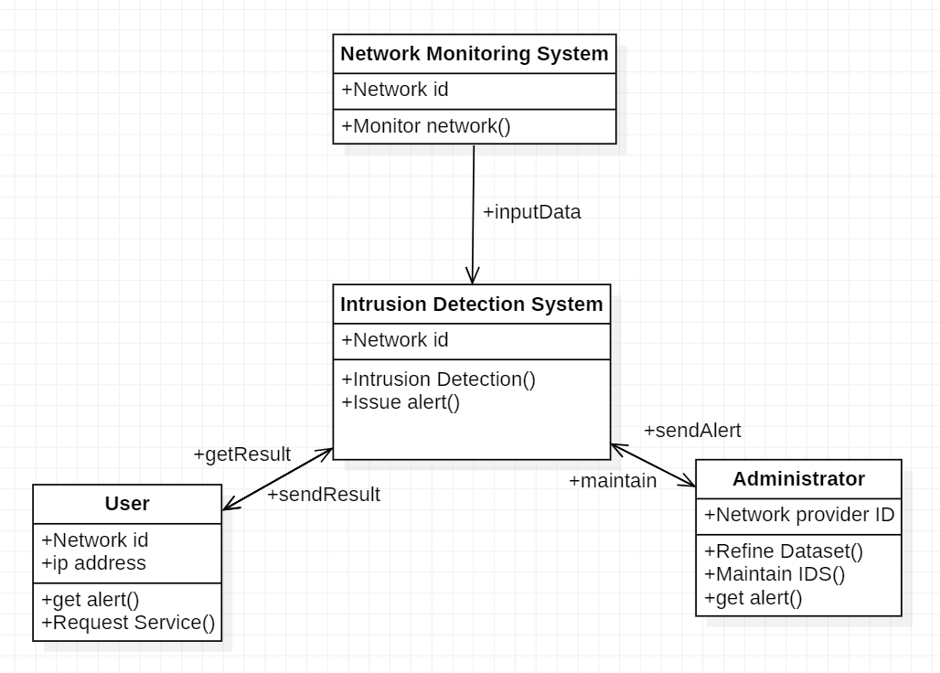
Class diagram

Slide 21
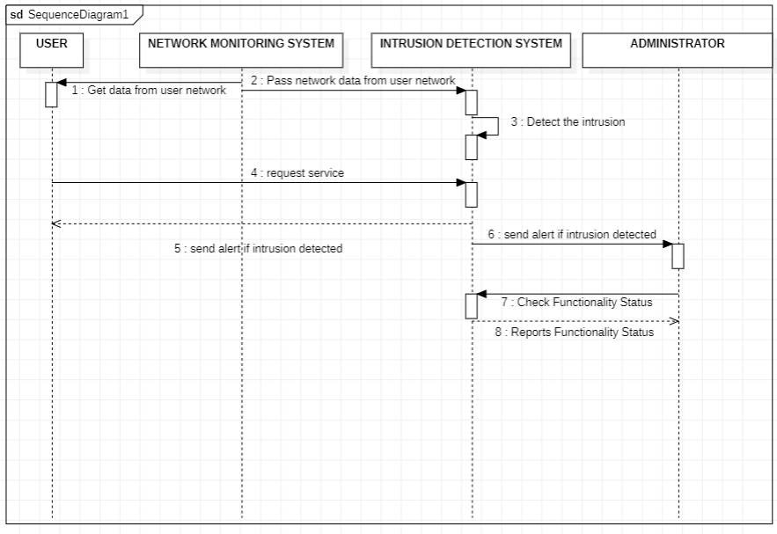
Sequence diagram

Slide 22
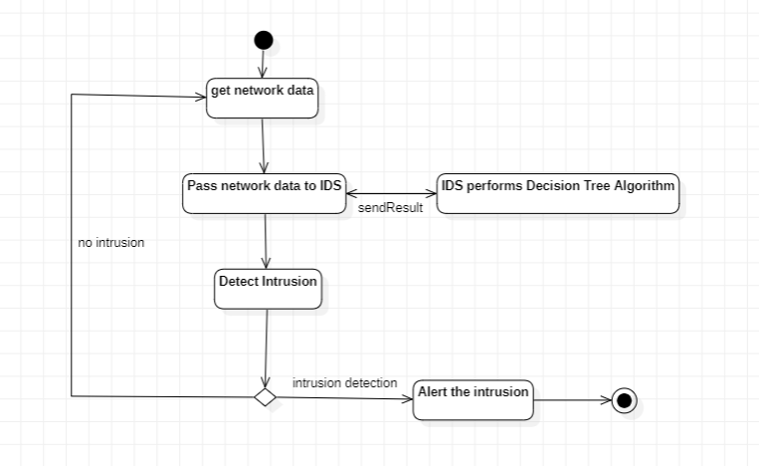
Activity Diagram

Slide 23
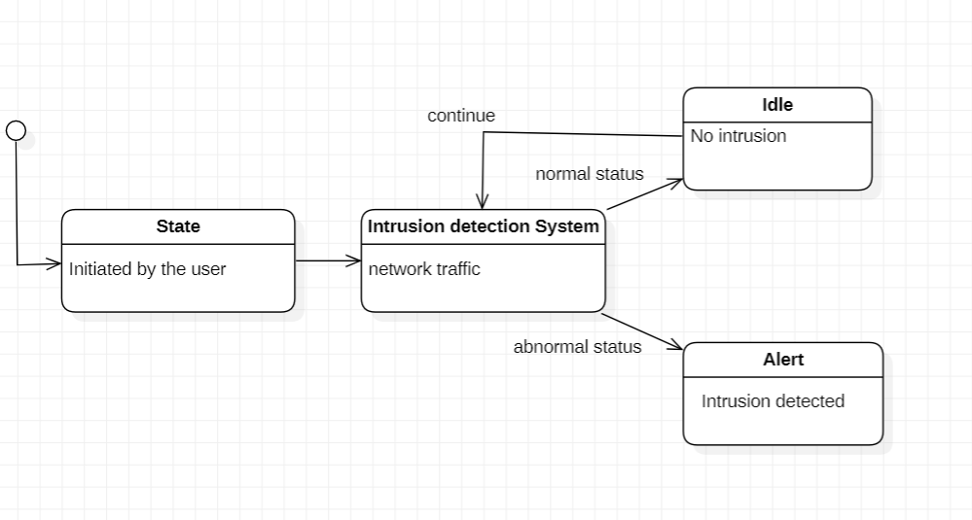
State Chart Diagram

Slide 24
The algorithm used in our IDS model is:
Decision Tree
Decision Tree:
It is a tree-structured classifier, where internal nodes represent the features of a dataset, branches represent the decision rules and each leaf node represents the outcome.
In a Decision tree, there are two nodes, which are the Decision Node and Leaf Node. Decision nodes are used to make any decision and have multiple branches, whereas Leaf nodes are the output of those decisions and do not contain any further branches.
In our project, the patterns based on the Indicators of Compromise (IoC) are represented as the branches (which makes up the path from one decision node to the other.) and the type of the attack is given by the leaf nodes.
The decision tree algorithm helps us find patterns and paths from the data that is available and it is has a predicted accuracy of 93% which has a upper hand over the currently used KNN algorithm.

Slide 25
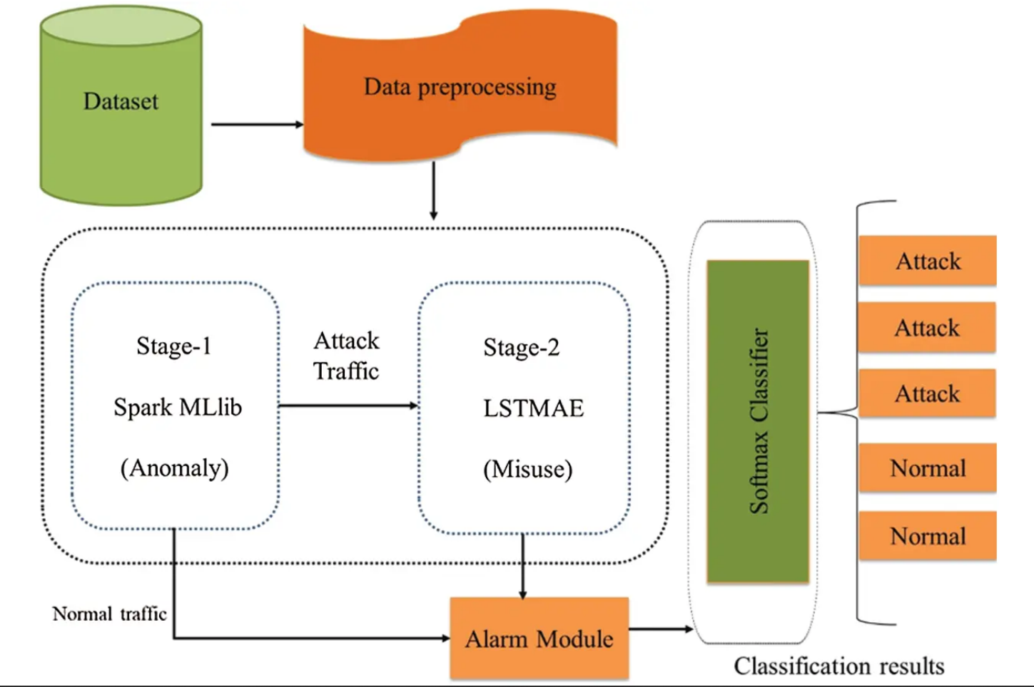
Data during implementation
CLASSIFICATION
FEATURE SCALING, FEATURE ELIMINATION, FEATURE SELECTION
ML MODEL

Slide 26
CODE:
LOADING THE DATASET
# attach the column names to the dataset-122 features
col_names = ["duration","protocol_type","service","flag","src_bytes",
"dst_bytes","land","wrong_fragment","urgent","hot","num_failed_logins",
"logged_in","num_compromised","root_shell","su_attempted","num_root",
"num_file_creations","num_shells","num_access_files","num_outbound_cmds",
"is_host_login","is_guest_login","count","srv_count","serror_rate",
"srv_serror_rate","rerror_rate","srv_rerror_rate","same_srv_rate",
"diff_srv_rate","srv_diff_host_rate","dst_host_count","dst_host_srv_count",
"dst_host_same_srv_rate","dst_host_diff_srv_rate","dst_host_same_src_port_rate",
"dst_host_srv_diff_host_rate","dst_host_serror_rate","dst_host_srv_serror_rate",
"dst_host_rerror_rate","dst_host_srv_rerror_rate","label"]
# KDDTrain+_2.csv & KDDTest+_2.csv are the datafiles without the last column about the difficulty score
# these have already been removed.
df = pd.read_csv("KDDTrain+_2.csv", header=None, names = col_names)
df_test = pd.read_csv("KDDTest+_2.csv", header=None, names = col_names)

Slide 27
FINDING CATEGORICAL DATA
print('Training set:')
for col_name in df.columns:
if df[col_name].dtypes == 'object' :
unique_cat = len(df[col_name].unique())
print("Feature '{col_name}' has {unique_cat} categories".format(col_name=col_name, unique_cat=unique_cat))
#see how distributed the feature service is, it is evenly distributed and therefore we need to make dummies for all.
print()
print('Distribution of categories in service:')
print(df['service'].value_counts().sort_values(ascending=False).head())
# Test set
print('Test set:')
for col_name in df_test.columns:
if df_test[col_name].dtypes == 'object’ :
unique_cat = len(df_test[col_name].unique())
print("Feature '{col_name}' has {unique_cat} categories".format(col_name=col_name, unique_cat=unique_cat))

Slide 28
LABEL ENCODER:
from sklearn.preprocessing import LabelEncoder,OneHotEncoder
categorical_columns=['protocol_type', 'service', 'flag']
# insert code to get a list of categorical columns into a variable, categorical_columns
categorical_columns=['protocol_type', 'service', 'flag']
# Get the categorical values into a 2D numpy array
df_categorical_values = df[categorical_columns]
testdf_categorical_values = df_test[categorical_columns]
df_categorical_values.head()
df_categorical_values_enc=df_categorical_values.apply(LabelEncoder().fit_transform)
ONE-HOT-ENCODING:
enc = OneHotEncoder()
df_categorical_values_encenc = enc.fit_transform(df_categorical_values_enc)
df_cat_data = pd.DataFrame(df_categorical_values_encenc.toarray(),columns=dumcols)
# test set
testdf_categorical_values_encenc = enc.fit_transform(testdf_categorical_values_enc)
testdf_cat_data = pd.DataFrame(testdf_categorical_values_encenc.toarray(),columns=testdumcols)
df_cat_data.head()

Slide 29
USING ANOVA F-TEST FOR FEATURE SELECTION:
from sklearn.feature_selection import SelectPercentile, f_classif
np.seterr(divide='ignore', invalid='ignore');
selector=SelectPercentile(f_classif, percentile=10)
X_newDoS = selector.fit_transform(X_DoS,Y_DoS)
X_newDoS.shape
BUILDING DECISION TREE MODEL:
clf_rfeDoS=DecisionTreeClassifier(random_state=0)
clf_rfeProbe=DecisionTreeClassifier(random_state=0)
clf_rfeR2L=DecisionTreeClassifier(random_state=0)
clf_rfeU2R=DecisionTreeClassifier(random_state=0)
clf_rfeDoS.fit(X_rfeDoS, Y_DoS)
clf_rfeProbe.fit(X_rfeProbe, Y_Probe)
clf_rfeR2L.fit(X_rfeR2L, Y_R2L)
clf_rfeU2R.fit(X_rfeU2R, Y_U2R)

Slide 30
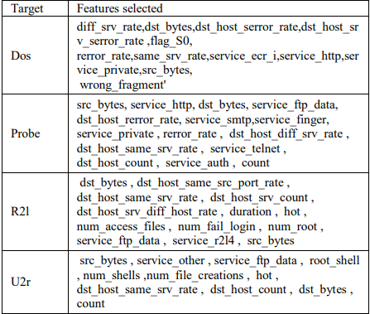
Features Selected after Anova F-test and Recursive Feature Elimination:

Slide 31
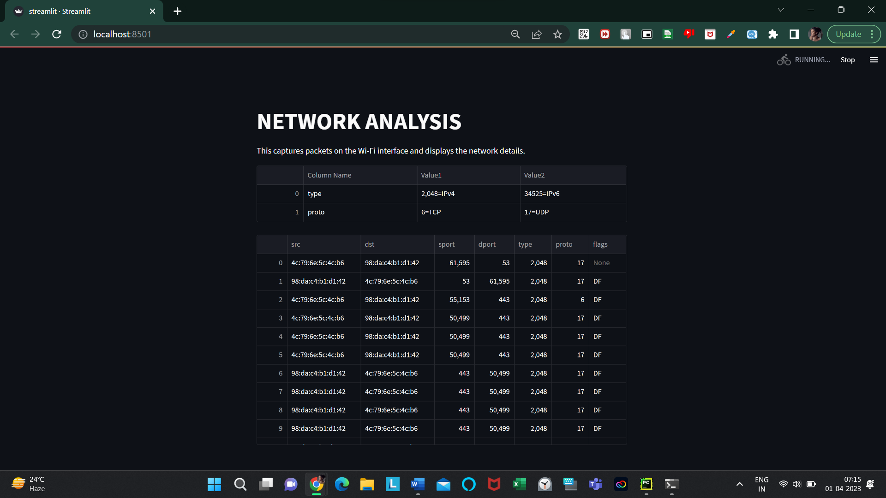
Implementation

Slide 32
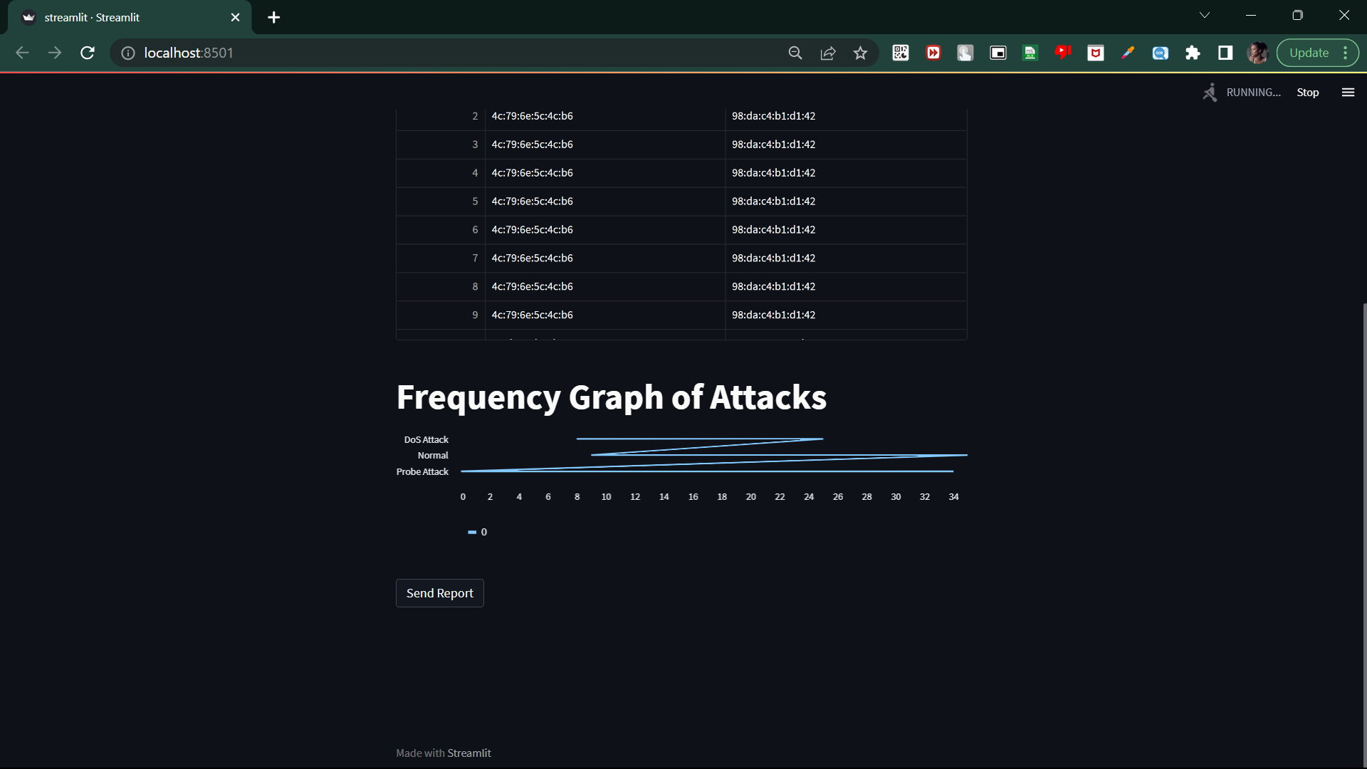

Slide 33
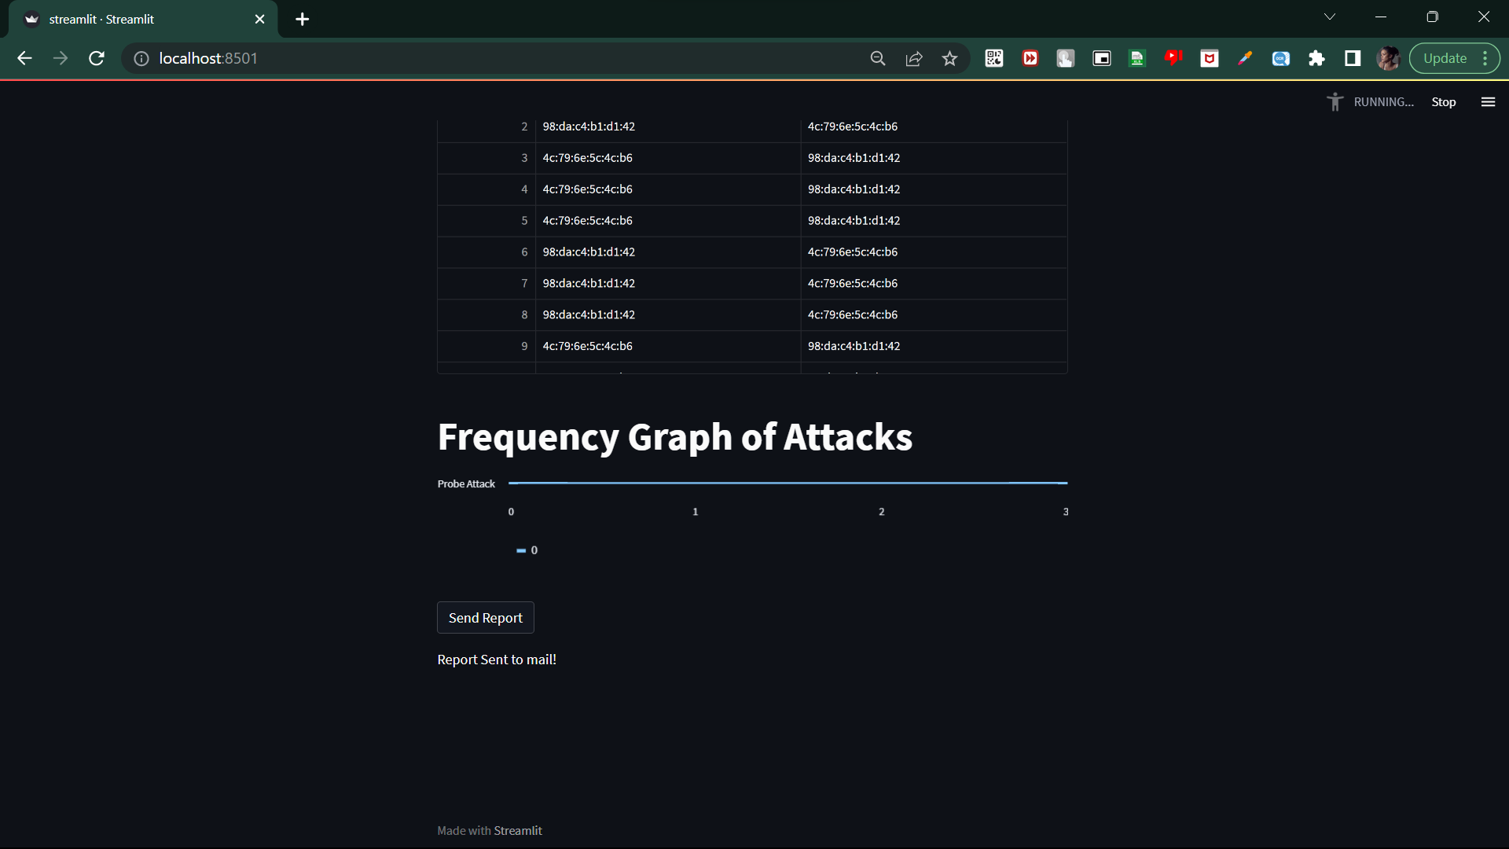

Slide 34


Slide 35


Slide 36
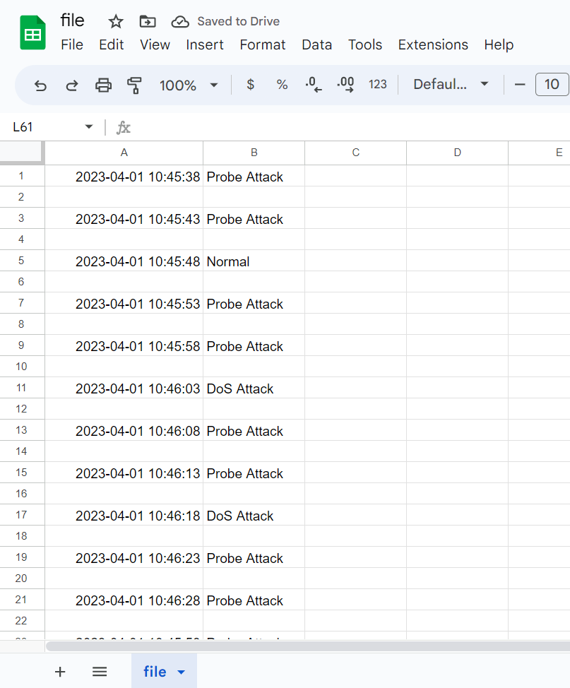

Slide 37
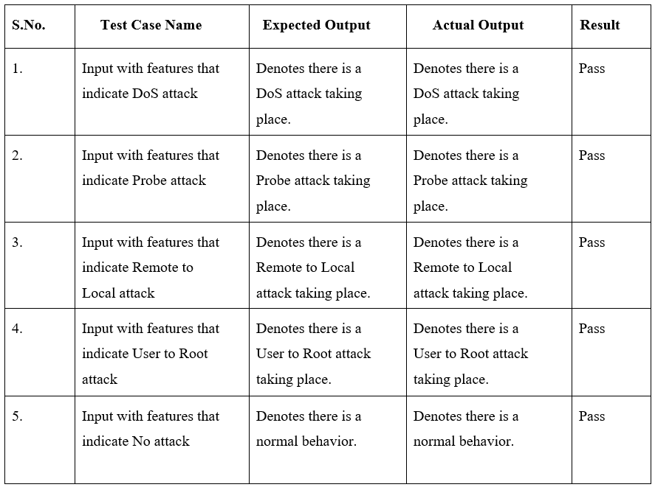
Test Cases

Slide 38
Future Work
The potential future enhancement for the proposed system could be the integration of a user behavior analytics (UBA) module. UBA can analyze the behavior of users and devices on the network, detect anomalies and identify potential security threats. By combining the insights from UBA with the intrusion detection system, it can provide a more advanced and comprehensive security solution.
It can be made more scalable and flexible by leveraging cloud-based infrastructure. By deploying the system on a cloud platform, it can be easily scaled up or down based on the network traffic volume, and thus this can provide a cost-effective and flexible solution.

Slide 39
THANK YOU

